Slide 1
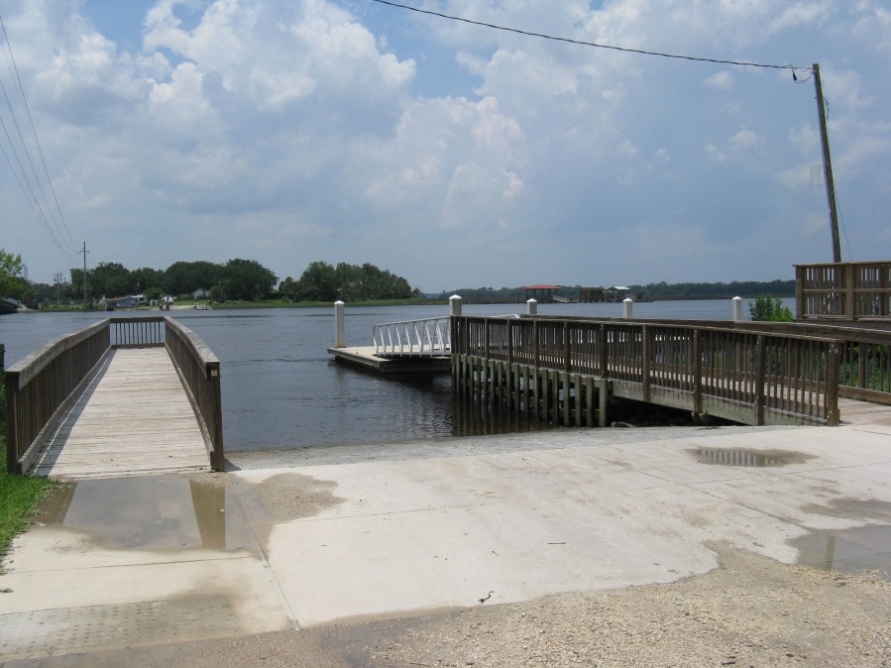
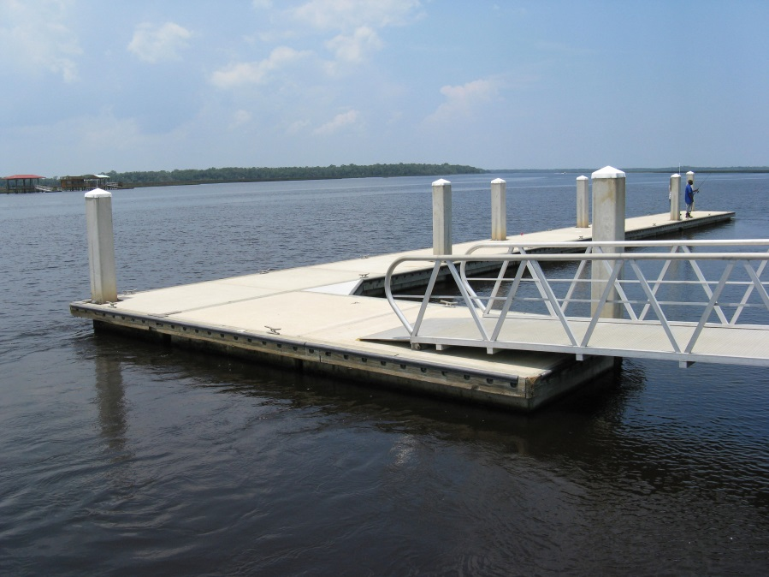
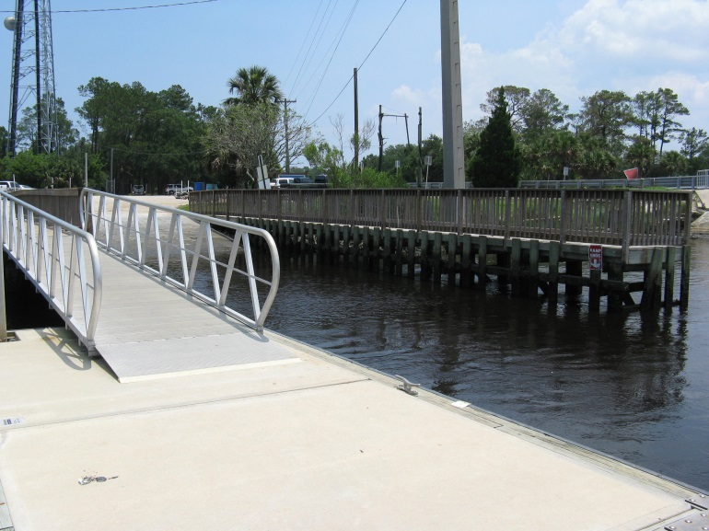
Palms Fish Camp
Existing Boat Facilities
2-Lane Boat Ramp
150’ Floating Dock to right of ramp
70’ Fixed Pier to left of ramp (no docking)

Slide 2
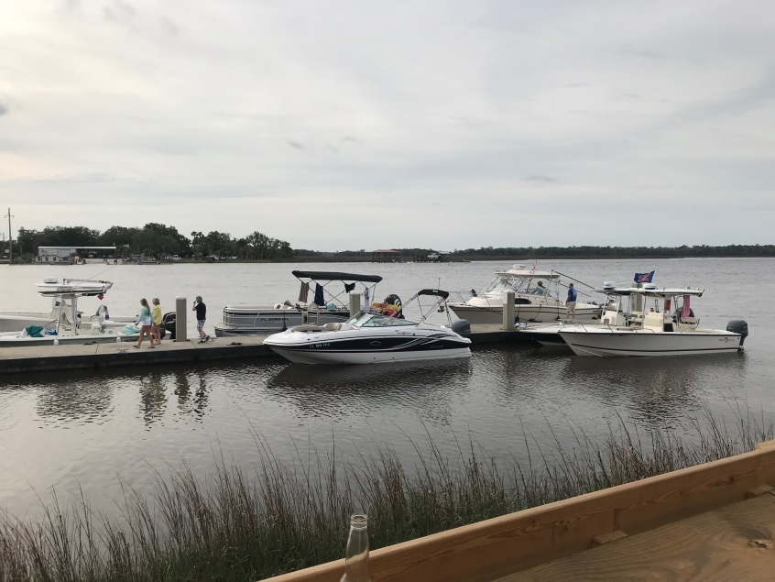
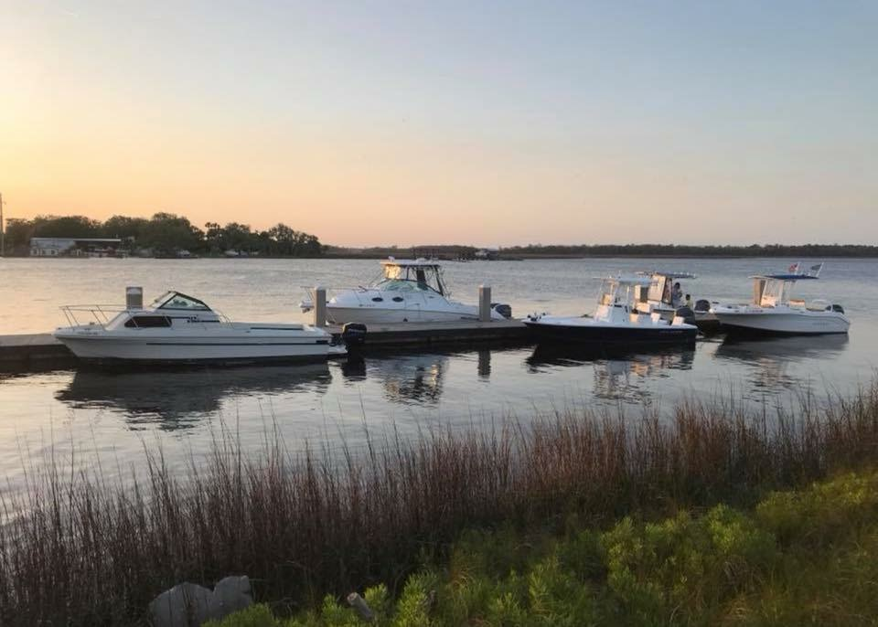
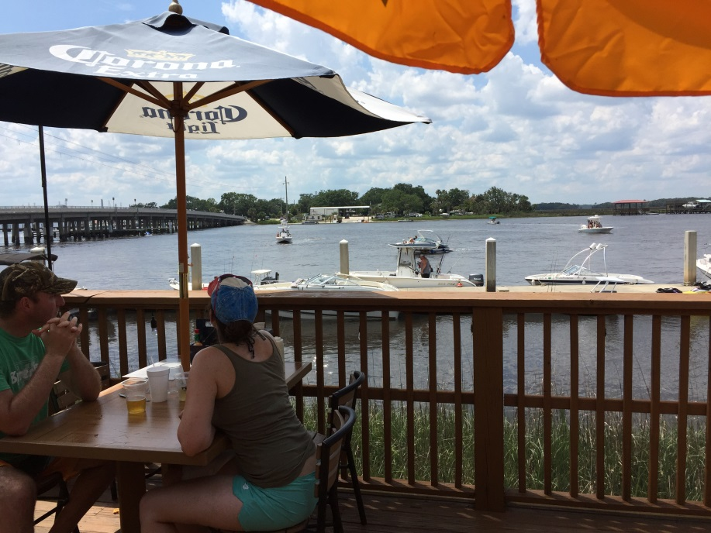
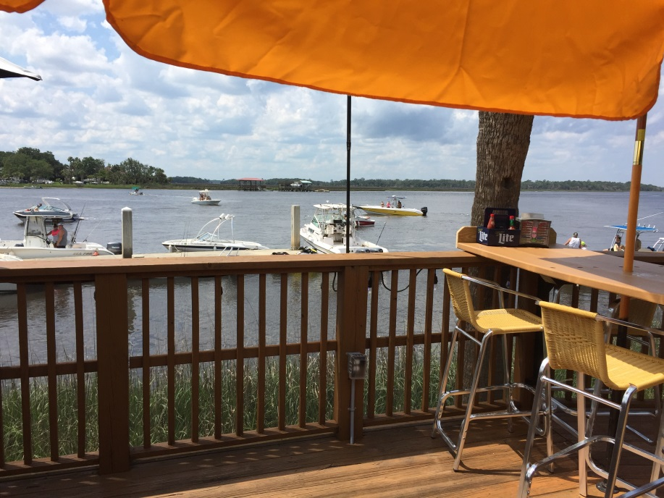
Palms Fish Camp
Increased Demand for Docking Space Since Restaurant Opening

Slide 3
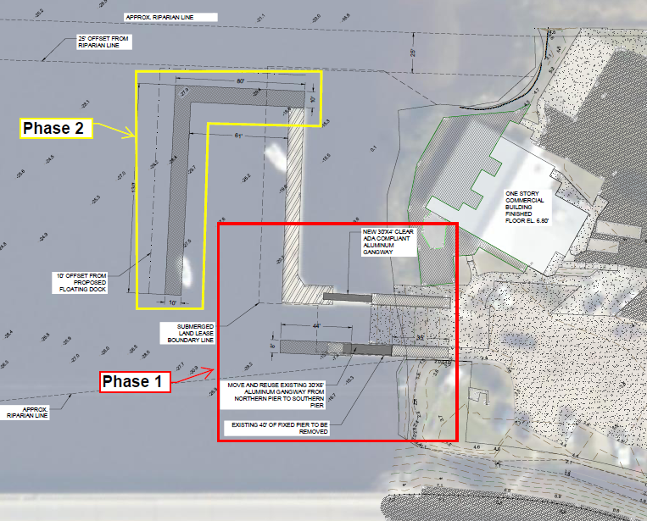
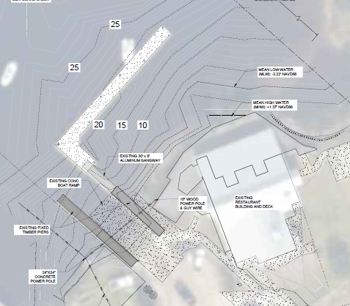
Palms Fish Camp
Planned Dock Expansion
Scope
Phase 1: Modify fixed pier & add floating dock w/gangway for ramp users to alleviate conflicts
Phase 2: Add 210 feet of additional floating dock to support demand created by restaurant
Construction Cost
Phase 1: $250,000
Phase 2: $700,000 (FIND application)
Proposed
Existing

